Slide 1

Predicting March Madness
Using Ridge & LASSO Regression to Predict Points Scored
By: Raymond Romaniuk

Slide 2
Introduction
March Madness (NCAA Basketball Tournament) is one of the largest sporting events in North America bringing together both sports fans and statistics enthusiasts.
The tournament began in 1939 and the tournament layout has remained the same since 2011 when the First Four play-in round was introduced
The 68 best teams in NCAA compete in the tournament
32 teams receive an automatic bid as their conference’s champion
36 teams receive an at-large bid as one of the 36 best remaining teams selected by the selection committee
The four lowest ranked automatic and at-large bid teams compete in the First Four for a spot in the First Round

Slide 3
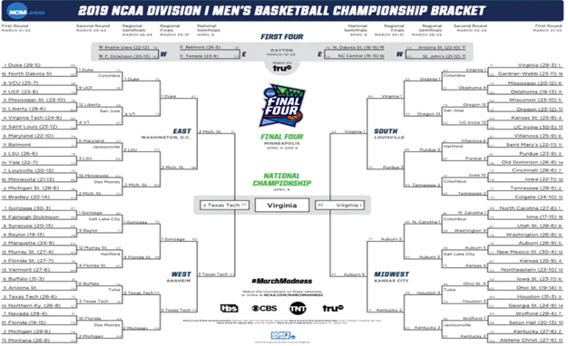
Introduction II
Each year millions of people fill out brackets in hopes of being the first person to predict the entire tournament

Slide 4
Introduction III
The odds of predicting the entire tournament correctly (if each team has an equal probability of winning each game) is:
1 in 9,223,372,036,854,775,808
(approx. 1 in 9.2 quintillion)

Slide 5
Problem
Which model best predicts the results of the 2021 March Madness Tournament?
Linear Regression
Ridge Regression (with/without k-fold cross validation)
LASSO Regression (with/without k-fold cross validation)

Slide 6
Data
Sources:
ESPN
Fox Sports
NCAA
Associated Press
Pomeroy College Basketball Ratings (by Ken Pomeroy)
Acquisition:
Data acquired using Python’s BeautifulSoup package to scrape relevant 2018 and 2019 tournament information
Data sets were then manipulated in order to combine the five data sources into one master data set

Slide 7
Data II
Data Structure:
268 observations in our data set
2 tournaments, 67 games per tournament, 2 observations per game
124 variables
Scoring data, win-loss breakdowns (home, away, neutral site etc.), strength of schedule, advanced analytics from KenPom
Sample of data structure for an individual game
Team | Wins | Loses | AP Rank | Opponent | Opp Wins | Opp Loses | Opp AP Rank
Gonzaga | 26 | 0 | 1 | Baylor | 22 | 2 | 3
Baylor | 22 | 2 | 3 | Gonzaga | 26 | 0 | 1

Slide 8
Data III
Data Manipulation:
Filled blank values in AP Rank & Pre-Season AP Rank, since only Top 25 teams receive a ranking
Data Issues:
Due to the pandemic teams played fewer games than previous seasons
Potential for points scored to be underestimated
Adjusted 2021 tournament participant data to be in terms of the average number of games played in previous seasons

Slide 9
Making Predictions
How are the predictions made?
The dependent variable that the models will be predicting is the points scored in a March Madness game
Each game has two teams, so two predictions of points scored will be made
The team with the higher number of points scored is the predicted winner

Slide 10
Training-Testing Split
Performed a random training-testing split to prevent the potential overfitting of our models
Randomly selected 100 games (200 observations) to be our training set
Remaining 34 games (68 observations) to be the test set

Slide 11
Model Estimation
All models created using Python’s scikit-learn library
All data used is standardized in terms of our training data, since variables are all on different scales
For example, Free Throw Attempts and Offensive Efficiency Margin

Slide 12
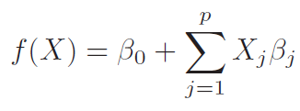
Linear Regression
First fit a simple linear regression as a benchmark for upcoming models
The linear regression model has the following form:
Initial linear regression model predicted 29/34 games, with a mean squared error of approximately 496.64

Slide 13
Bias-Variance Trade-Off
Next, ridge and LASSO regression will introduce bias into our model allowing the most influential variables to contribute most to the predicted points scored
A model with high variance and low bias will risk overfitting our training data, while a model with low variance and high bias will risk underfitting our data
A model with greater variance has a higher model complexity and more effective degrees of freedom

Slide 14
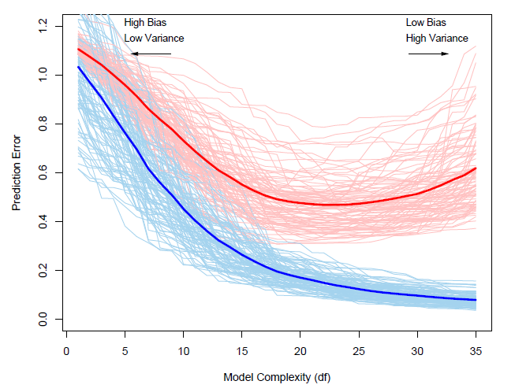
Bias-Variance Trade-Off II
We wish to find the model that minimizes the prediction error on our testing data (the red curve below)

Slide 15

Ridge Regression
Similar to linear regression, ridge regression estimates its coefficients by minimizing the residual sum of squares
Ridge regression adds a penalty term that will shrink the magnitudes of our coefficients and allow the more influential variables to have more impact on the prediction of points scored
The ridge coefficients are estimated by minimizing the following equation in terms of beta
$${\hat{β}}^{ridge}= \min_{β}\left\{\sum_{i=1}^{N}{{(y_{i}−\sum_{j=0}^{p}{x_{ij}∙β_{j}})}^{2}+λ∙\sum_{j=0}^{p}{β_{j}^{2}}}\right\}$$
The ridge regression solution can also be derived by hand finding the following formula:
$${\hat{β}}^{ridge}={(X^{T}X+λI)}^{−1}∙X^{T}y$$

Slide 16

Ridge Regression II
$${\hat{β}}^{ridge}= \min_{β}\left\{\sum_{i=1}^{N}{{(y_{i}−\sum_{j=0}^{p}{x_{ij}∙β_{j}})}^{2}+λ∙\sum_{j=0}^{p}{β_{j}^{2}}}\right\}$$
The last term is our new penalty, specifically an $L_{2}$ penalty
$λ$ is a constant adjusting the weight of the penalty
A small $λ$ provides larger estimations of our coefficients (with $λ$ = 0 being our simple linear regression model)
A large $λ$ provides smaller estimations of our coefficients
Want to find $λ$ that minimizes the mean squared error of our predictions

Slide 17
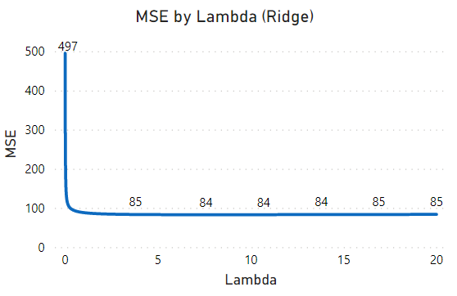
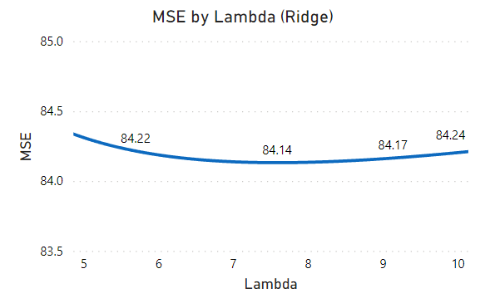

Ridge Regression III
Fit models for all $λ^{′}s$ in the range 0-20 (3 decimal precision) to find the $λ$ that minimizes the mean squared error
$λ$ = 7.582 minimizes the mean squared error
Optimal ridge regression model predicted 27/34 games, with a mean squared error of 84.14
Significant improvement in mean squared error from linear model (496.64)

Slide 18

LASSO Regression
Estimation of LASSO regression coefficients similar to ridge regression coefficients
Difference being the inclusion of an $L_{1}$ penalty in the LASSO estimation compare to the $L_{2}$ penalty in the ridge regression
$${\hat{β}}^{LASSO}= \min_{β}\left\{\sum_{i=1}^{N}{{(y_{i}−\sum_{j=0}^{p}{x_{ij}∙β_{j})}}^{2}+λ∙\sum_{j=0}^{p}{\left|β_{j}\right|}}\right\}$$
New penalty term allows coefficients to be estimated as zero, since a small change in the derivative of $β$ is the same for all $β$’s, small $β$ values receive a large penalty relative to their magnitude
Also, due to the absolute value being non-differentiable at zero there exists no simple solution and estimates must be found numerically

Slide 19
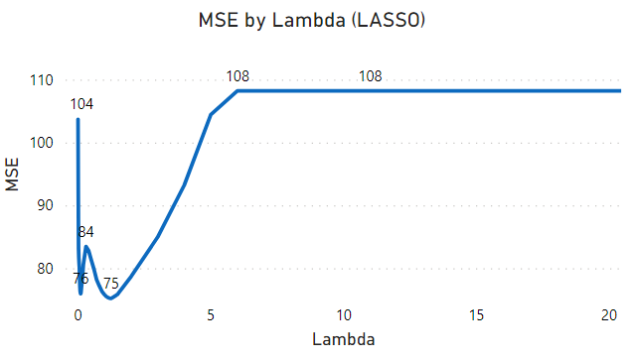
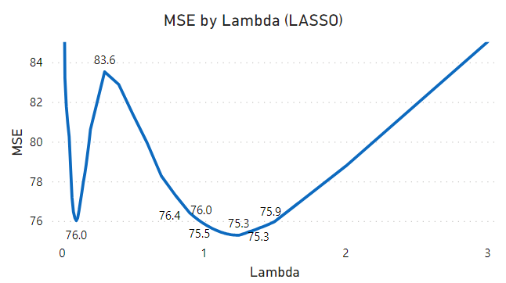

LASSO Regression II
Like, ridge regression we can find the $λ$ that minimizes the mean squared error of our predictions
$λ$ = 1.246 minimizes the mean squared error, only 12 variables have a non-zero coefficient (approx. 10% of our coefficients are non-zero)
Optimal LASSO regression model predicted 29/34 games, with a mean squared error of approximately 75.31
Improvement on our optimal ridge regression model

Slide 20

K-Fold Cross-Validation
With only one random split our models potentially suffer from a poor training-testing split
Use k-fold cross-validation to reduce the impact of a poor split
Split data into k folds/samples and estimate models based on the k samples
Each sample holds out one fold for testing and fits model to the remaining k-1 folds
We can then find the value of $λ$ that minimizes the average mean squared error over our k folds and use them for our final ridge and LASSO models

Slide 21
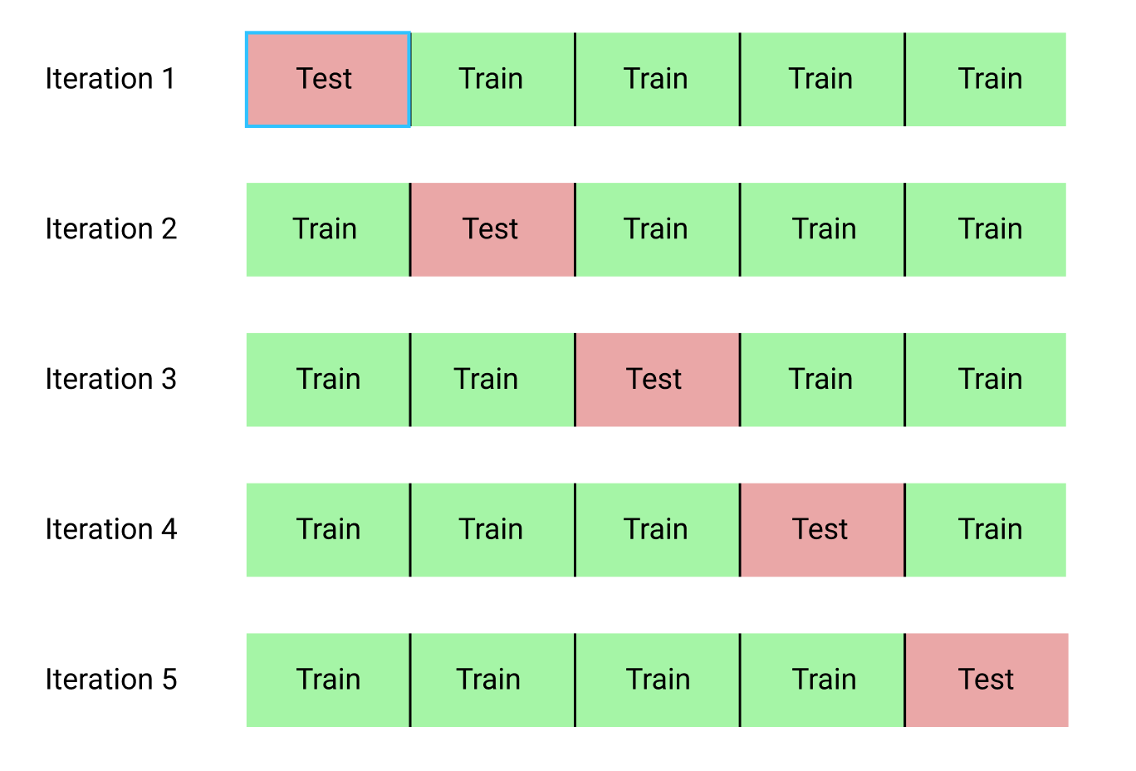
K-Fold Cross-Validation II
We will use k = 5 folds to estimate our models

Slide 22
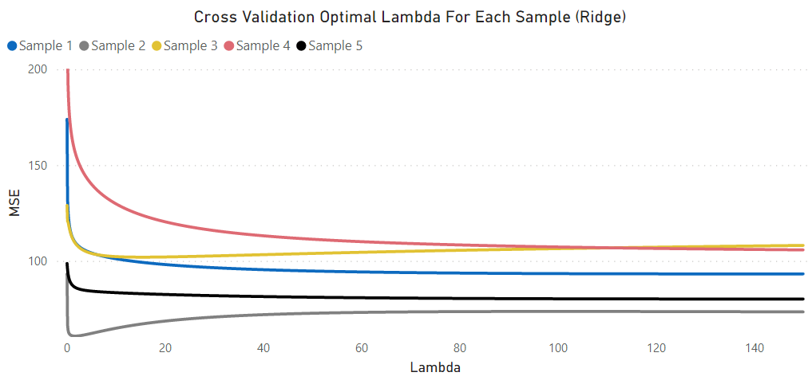
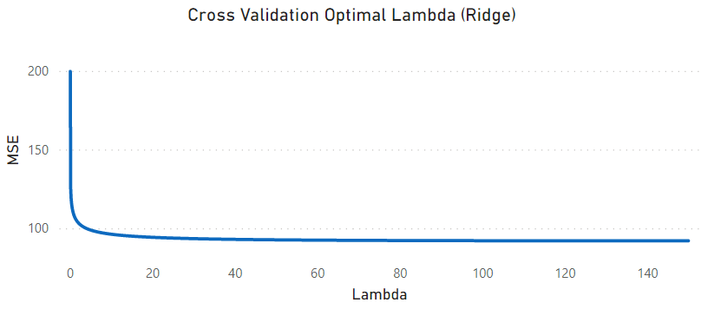
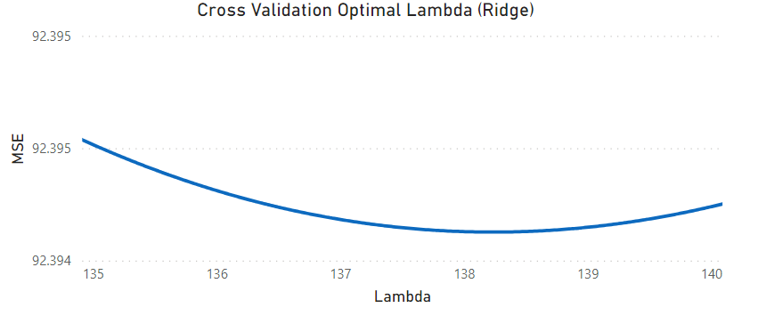


Ridge Regression (K-Fold CV)
Use 5-fold cross validation to find our optimal ridge regression $λ$ value
The optimal $λ$ value for our final ridge regression model is 138.23

Slide 23
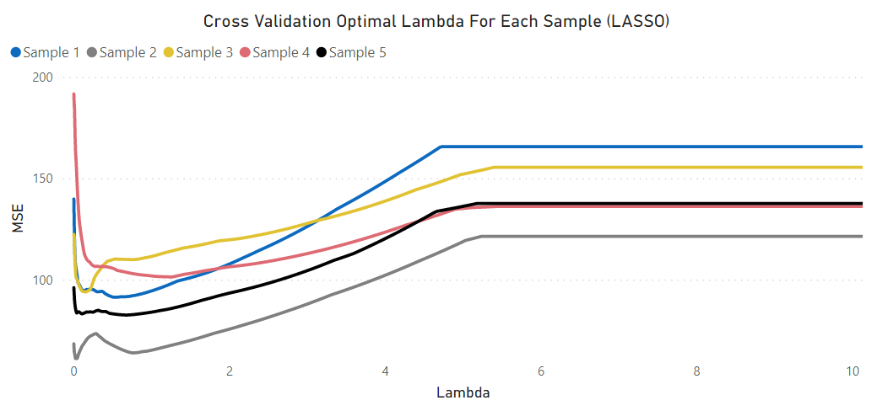
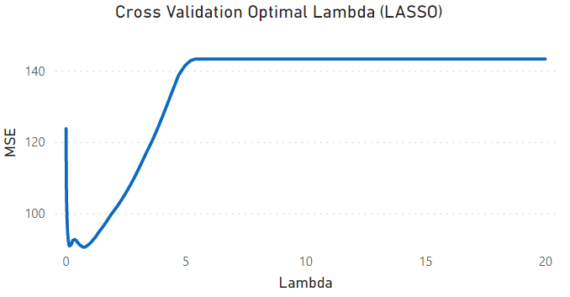
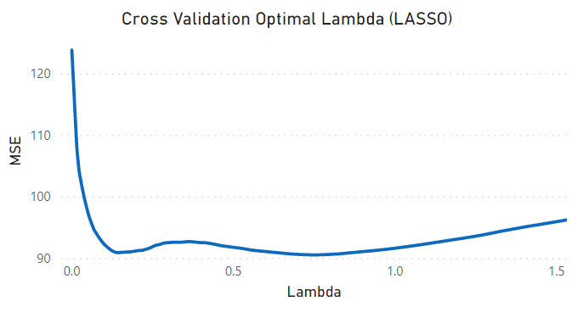


LASSO Regression (K-Fold CV)
Use 5-fold cross validation to find our optimal LASSO regression $λ$ value
The optimal $λ$ value for our final LASSO regression model is 0.748

Slide 24
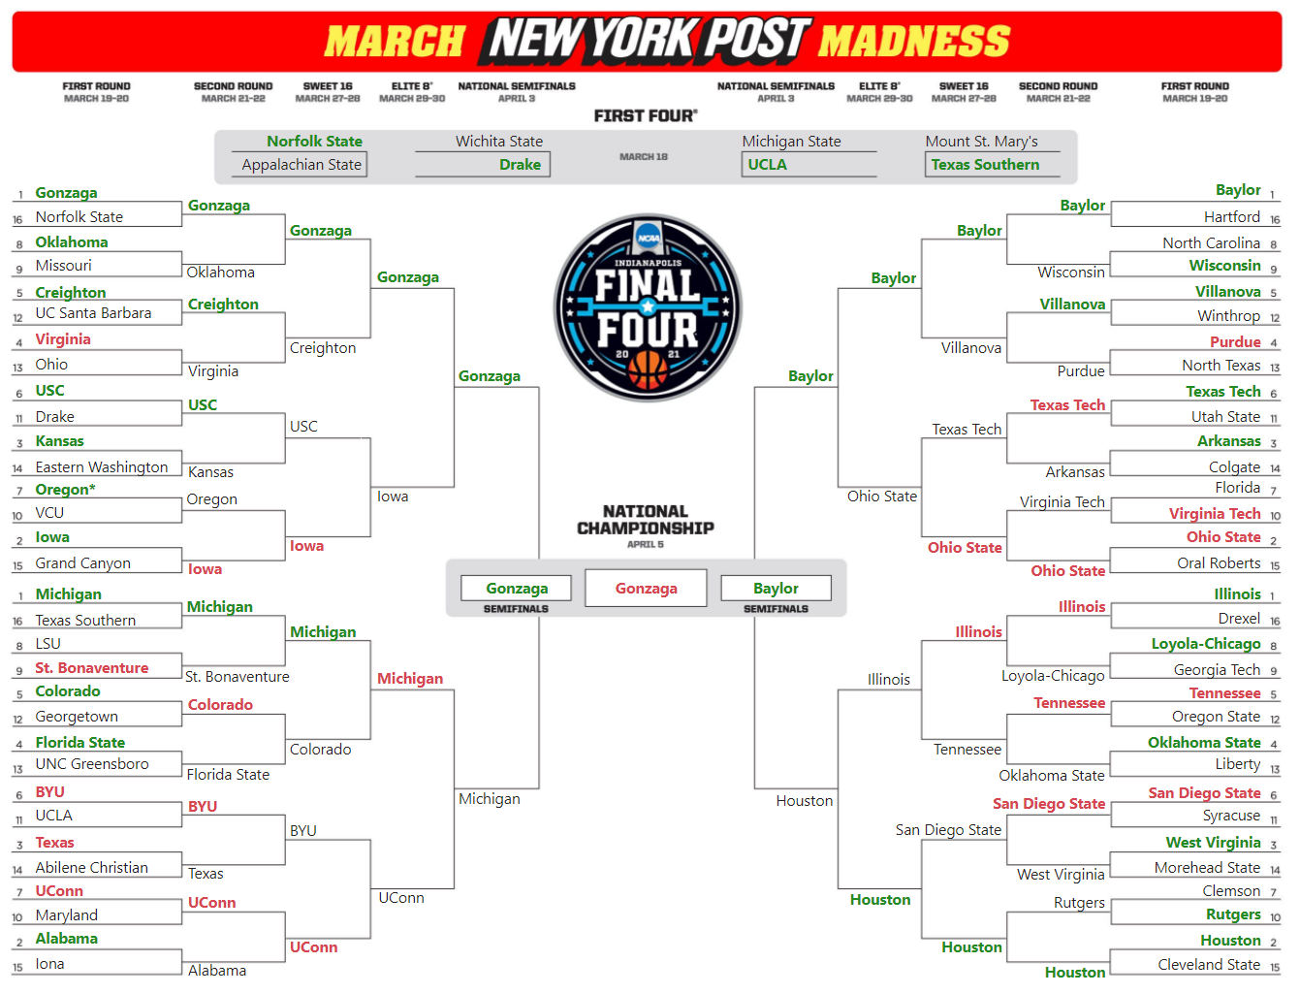
Results
The complete bracket of the final LASSO regression model predictions

Slide 25
Results II
In addition to the ridge and LASSO regression predictions, I filled out my own predictions
The below table shows how each bracket fared
All three brackets performed well, with the LASSO model even correctly predicting all four First Four games
* Correct Oregon prediction not included due to game cancellation from VCU COVID-19 case
Round | LASSO | Ridge | My Predictions | Games
First Four | 4 | 2 | 2 | 4
First Round | 21* | 20 | 23 | 31
Second Round | 7 | 8 | 8 | 16
Sweet Sixteen | 4 | 4 | 4 | 8
Elite Eight | 3 | 3 | 2 | 4
Final Four | 2 | 2 | 2 | 2
Championship | 0 | 1 | 0 | 1
Total | 41 | 40 | 41 | 66

Slide 26
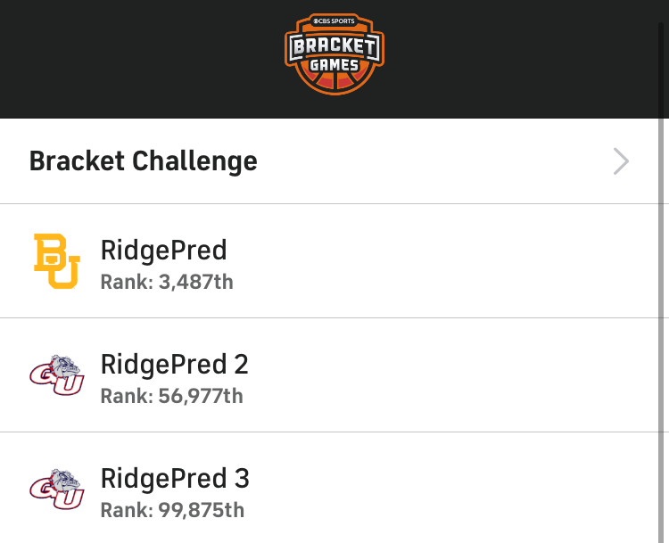
Results III
All three of the brackets were submitted to the CBS Sports Bracket Challenge containing at least 770,000 brackets
Our ridge model correctly predicted the tournament champion and placed very high in the competition
RidgePred represents the ridge regression predictions
RidgePred 2 represents the LASSO regression predictions
RidgePred 3 represents my predictions

Slide 27
Results IV
Cannot make an exact comparison between our previous ridge and LASSO predictions, since as tournament progressed models predicted different matchups
Made predictions on the actual matchups that took place in the tournament
The final LASSO model predicted more games than the ridge regression model and had a lower mean squared error of 223.50 compared to 248.90
Round | LASSO | Ridge | Games
First Four | 4 | 2 | 4
First Round | 21 | 20 | 31
Second Round | 9 | 9 | 16
Sweet Sixteen | 6 | 6 | 8
Elite Eight | 3 | 3 | 4
Final Four | 2 | 2 | 2
Championship | 0 | 1 | 1
Total | 45 | 43 | 66

Slide 28
Notable Upsets
#10 Rutgers against #7 Clemson (LASSO & Ridge)
#6 USC against #3 Kansas (LASSO)
#11 Syracuse against #6 San Diego State (Ridge)
#8 Loyola-Chicago against #1 Illinois (Ridge)
#11 Syracuse against #3 West Virginia (Ridge)

Slide 29
Conclusion
Introduction of bias through ridge and LASSO regression significantly improved the mean squared errors of our predictions
Each of our models outperformed the majority of the general public's brackets
LASSO regression seems to be the better model for predicting both game outcomes and the number of points scored
As with any model there is room for improvement in the future, but these models performed well and seem to be good starting points to build from in the future

